Slide 1
Robotics Safety

Slide 2
A story to share…
At the 2008 Florida Regional, a college student mentor was working on their team's robot, and it was running autonomous mode. When it stopped running, he noticed a problem. He reached inside the robot and his index finger was pushing down on a chain when the robot started up again - I believe after a pause in the software. The chain grabbed his finger and pulled it into the adjacent sprocket where it severed his finger at the first knuckle. They were unable to reattach it at the hospital.
I know I get complacent sometimes, but this really woke me up. No dongle or switch would have reacted in time to stop this, and you can't put physical guards everywhere. Power down anytime you are working on your robot. Please read this to your teams and remind them of all the dangers involved in working with machines and machinery.

Slide 3
General Safety…
Robot pinch points – Know where your fingers are likely to get stuck!
When operating a robot – someone should be responsible for emergency shut down!
Turn off robot at power switch
Hit the disable switch, which is enter.
Don’t put tools at the edge of tables!!
Tie back long hair, and/or remove baggy clothing/hoodies, this includes strings.

Slide 4
More General Safety…
Clear a workspace before you begin a task. The time spent preparing your work and area is time saved in the long run.
SAFETY GLASSES must be worn when using machinery (or within 5’-20’ depending on machine) and is mandatory in mechanical.
Closed toed shoes must be worn around machinery and robots.
Ear protection when using loud tools.

Slide 5
Even More General Safety…
Know where Fire Extinguisher is located.
Know what to do in an emergency.
If you get injured, you must notify a mentor and/or veteran! Don’t try to hide it or be embarrassed.
Think about the worst case scenario before starting a job to prepare your thought process with safety in mind.
PUT TOOLS AND BITS AWAY WHEN FINISHED!!

Slide 6
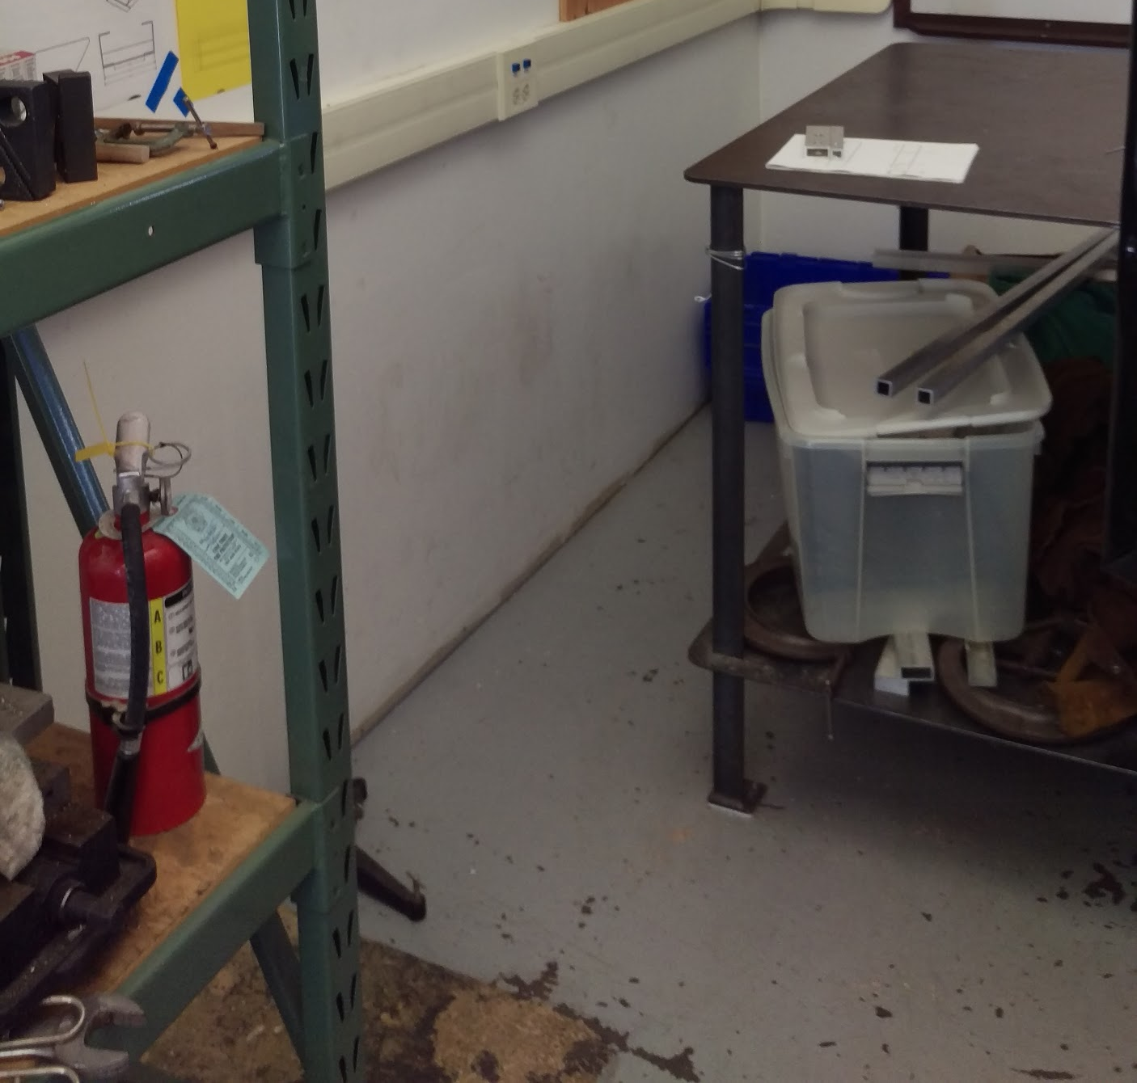
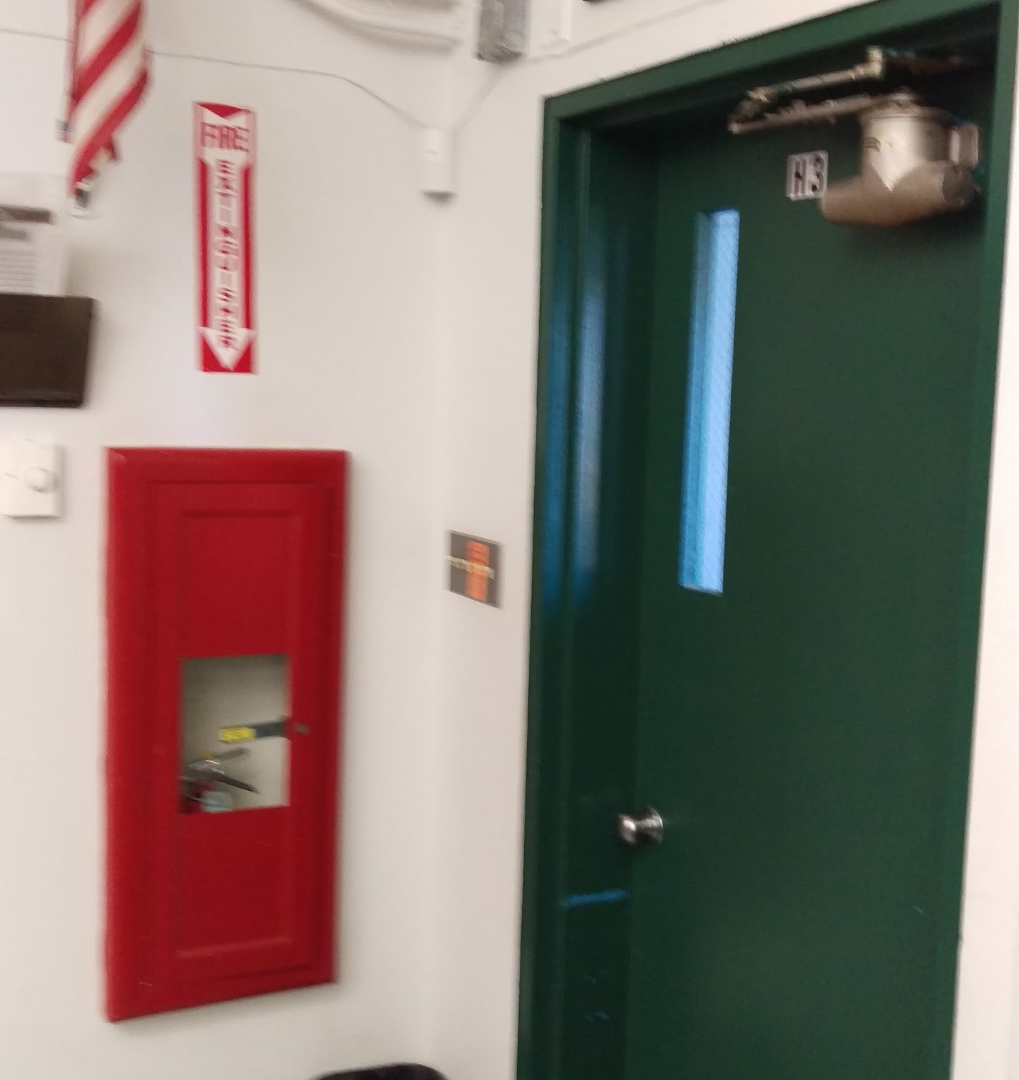
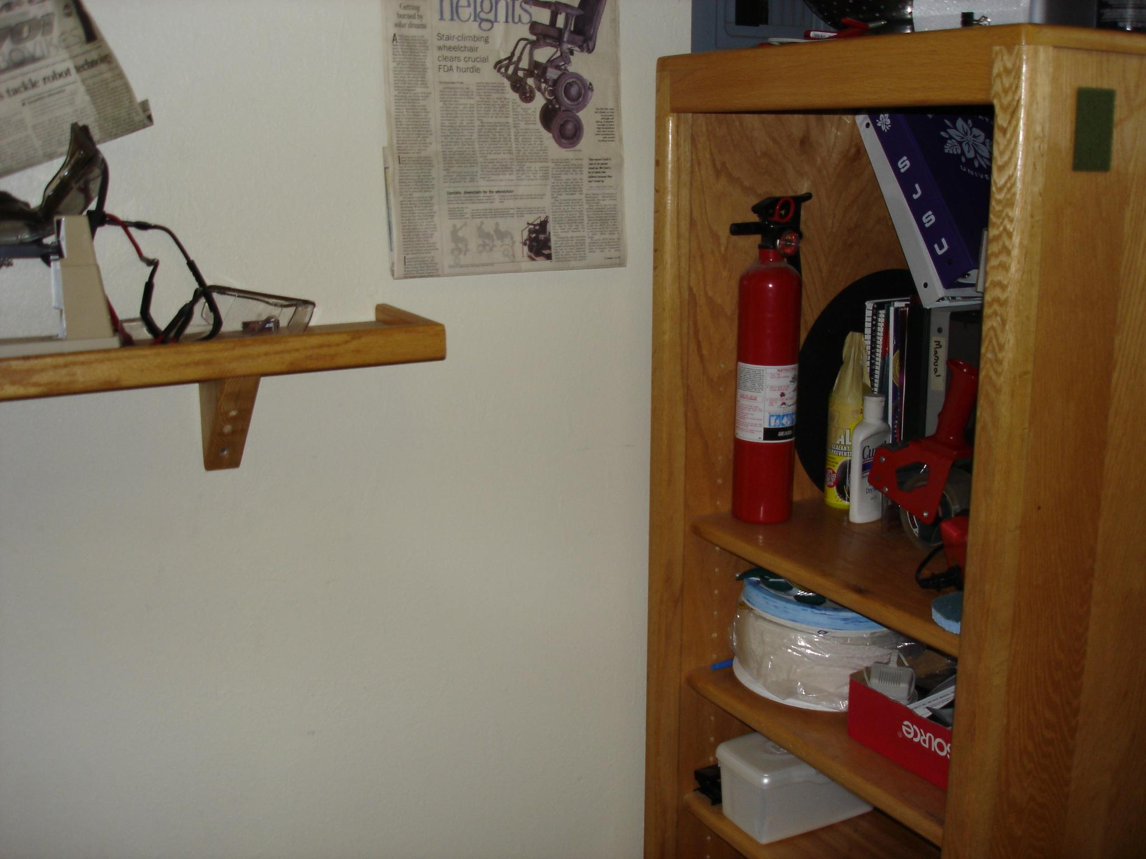
H-3 Drafting Room
Welding Area
Electronics Room
Mechanical Room

Slide 7
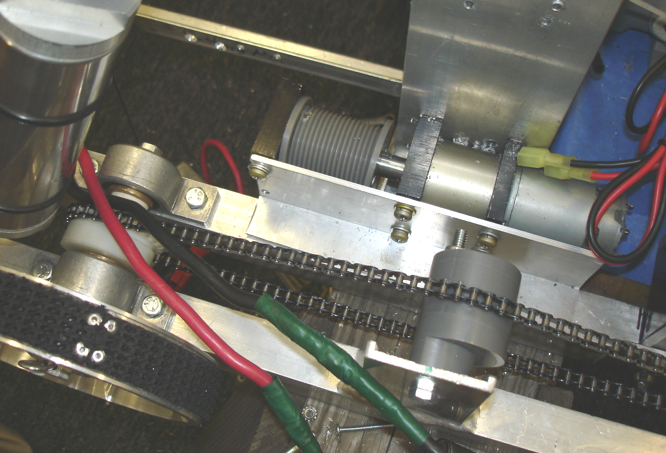
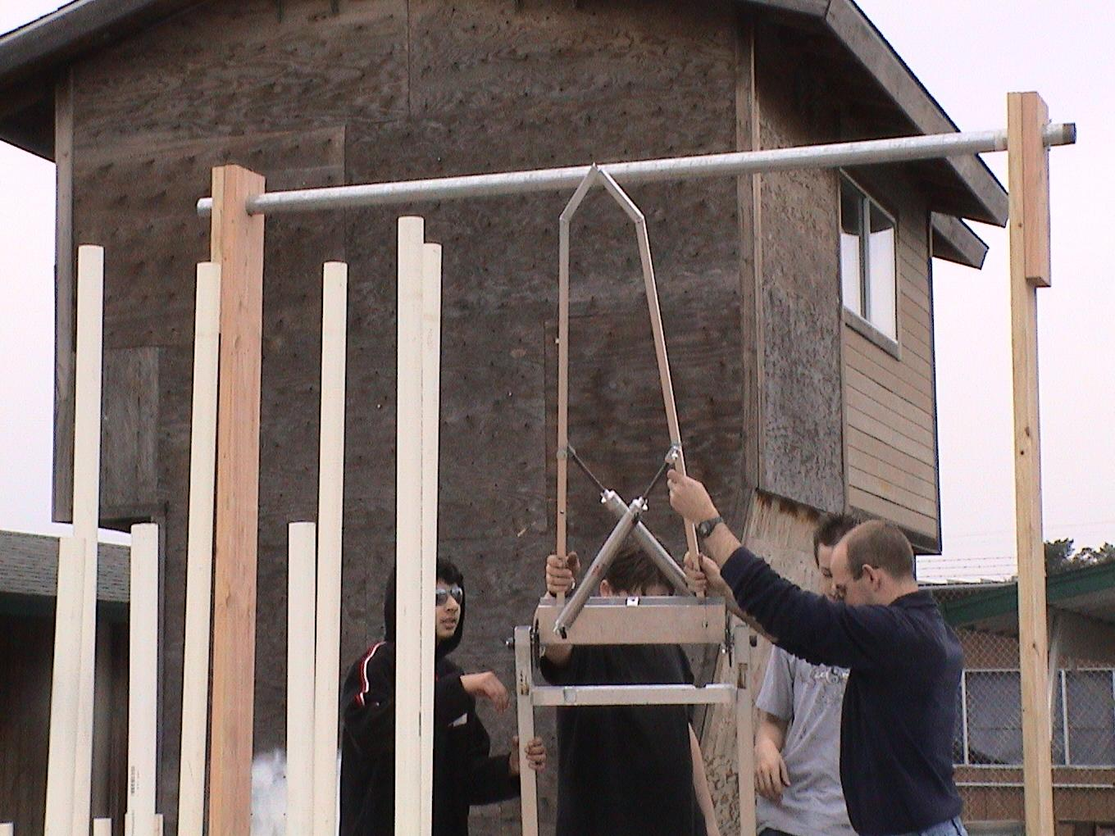
Pinch Points!!

Slide 8
Hand / Cordless Drills
Use a Scratch Awl and metal ruler to locate and mark the center point for the hole you will drill.
Center punch a dimple in that location.
Use a Center Drill to start the hole… this increases precision. (Optional)
Clamp piece to a table to keep it from moving
Then use the correct size drill for the hole and keep an eye on the cordless drill to ensure you drill straight!
Don’t leave cordless drills at the edges of tables or in an upright position.
SAFETY GLASSES

Slide 9
CNC Milling
HAAS stuff - Only trained student who have been certified by Mr. Green can run the HAAS machines.
Use a Vise or Finger Clamps to hold down the piece your cutting.
SAFETY GLASSES!!!
Keep your hand on or near the E-Stop. (The big red button)

Slide 10
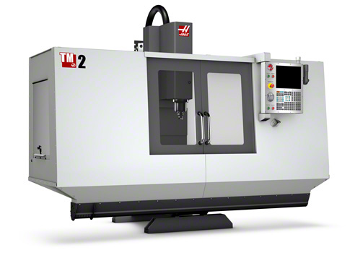

Slide 11
Disc / Belt Sander
Loose clothing out of the way. Hair tied back
When metal is sanded, the friction causes a lot of heat, so the piece you’re holding will get hot! Use pliers or vise grips to hold the piece if this happens. Don’t wear gloves!
Make sure to cut on the down turning side of the disc sander.
Use a miter guide to get a straight edge.
By moving the piece side to side, it will allow that portion of the sander to cool down. It also keeps the paper from tearing.
SAFETY GLASSES!!!!

Slide 12
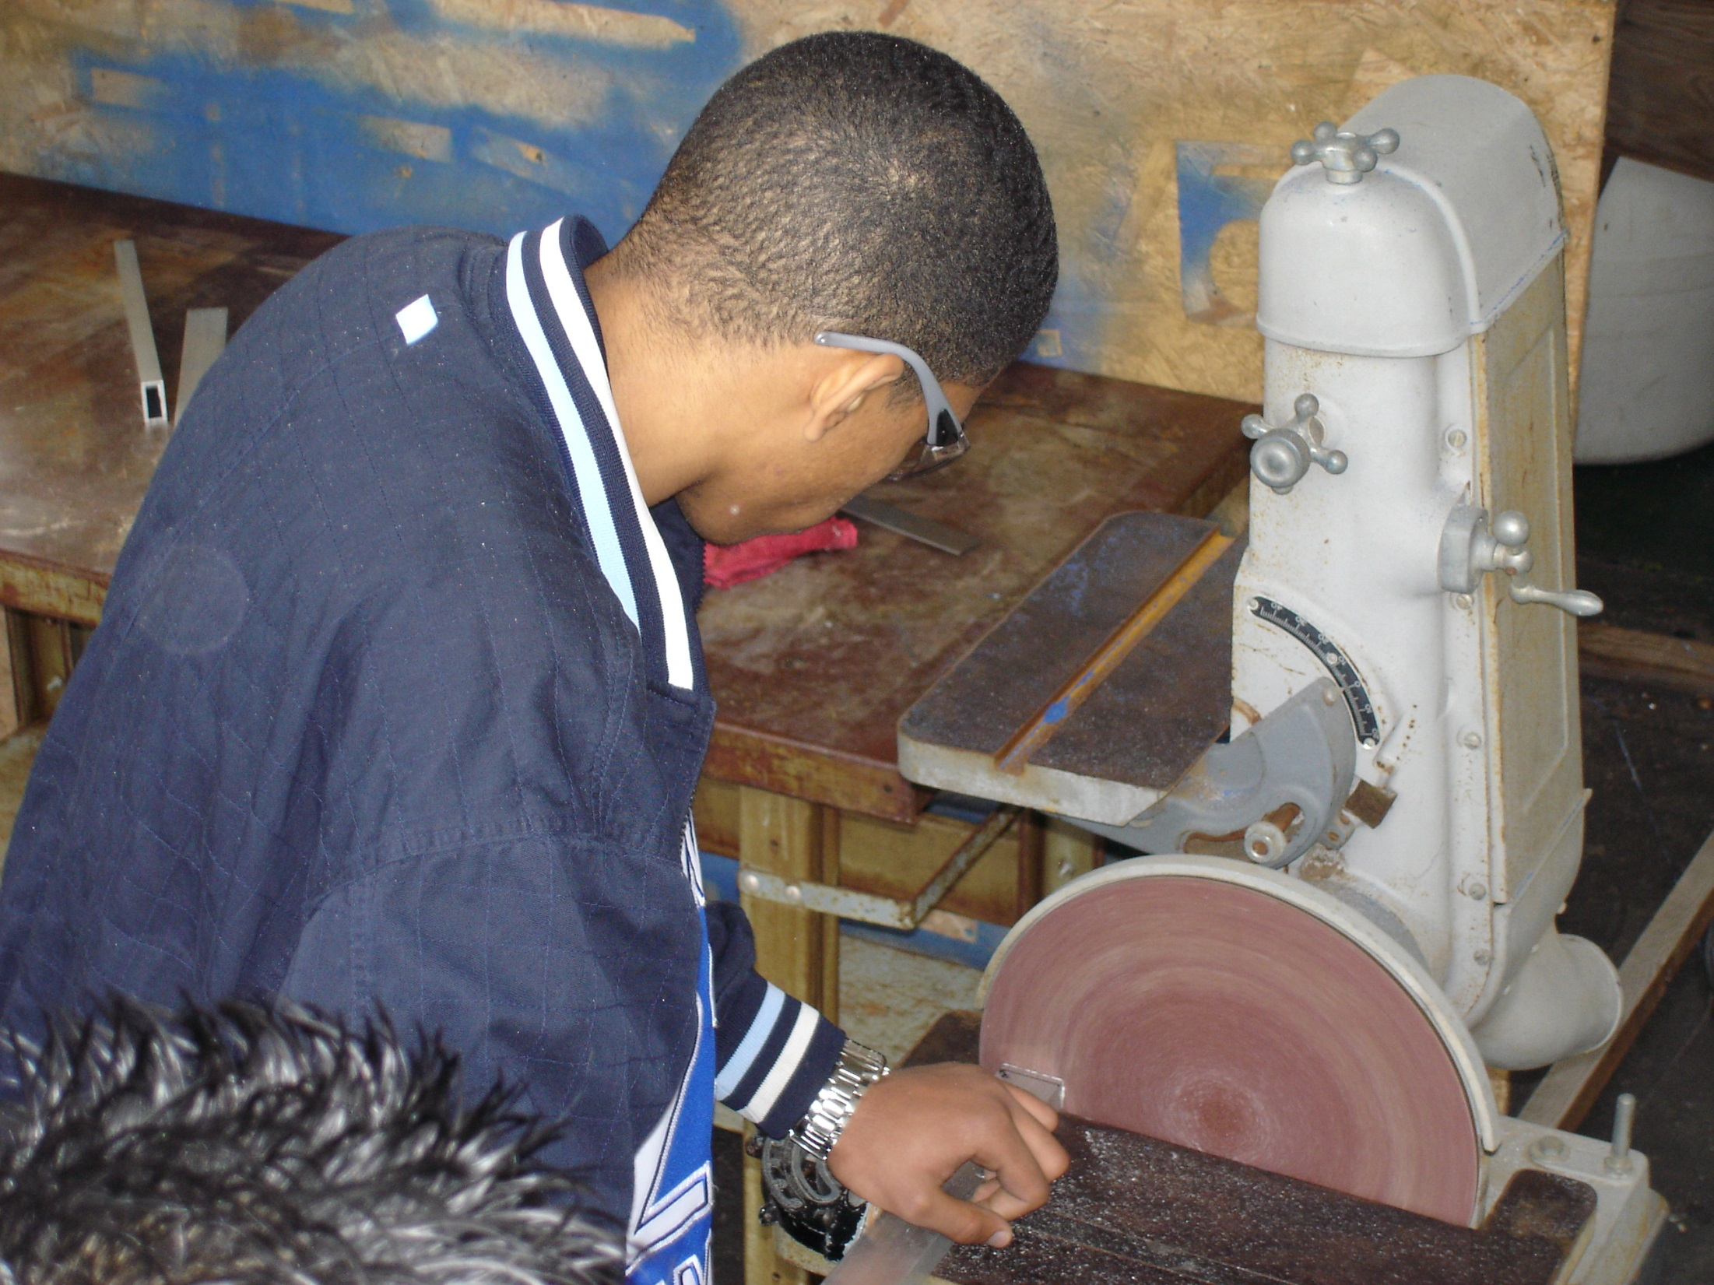
Safety Glasses
Miter Guide
Sand on the down side!
OUCH – HOT!

Slide 13
Band Saw
Loose clothing out of the way and hair tied back
Lower the guard about ¼” above the piece for clearance.
To cut rounded edges or corners, make relief cuts so the blade doesn’t bend.
DON’T FORCE MATERIAL THROUGH THE BAND SAW!!! Let it cut at it’s own pace. Listen to the motor, if it slows down a lot – you are going to fast.
Check the blade for molten aluminum if it isn’t cutting smooth.
The Band Saw in the mechanical room is setup for cutting aluminum only.
SAFETY GLASSES!!!

Slide 14
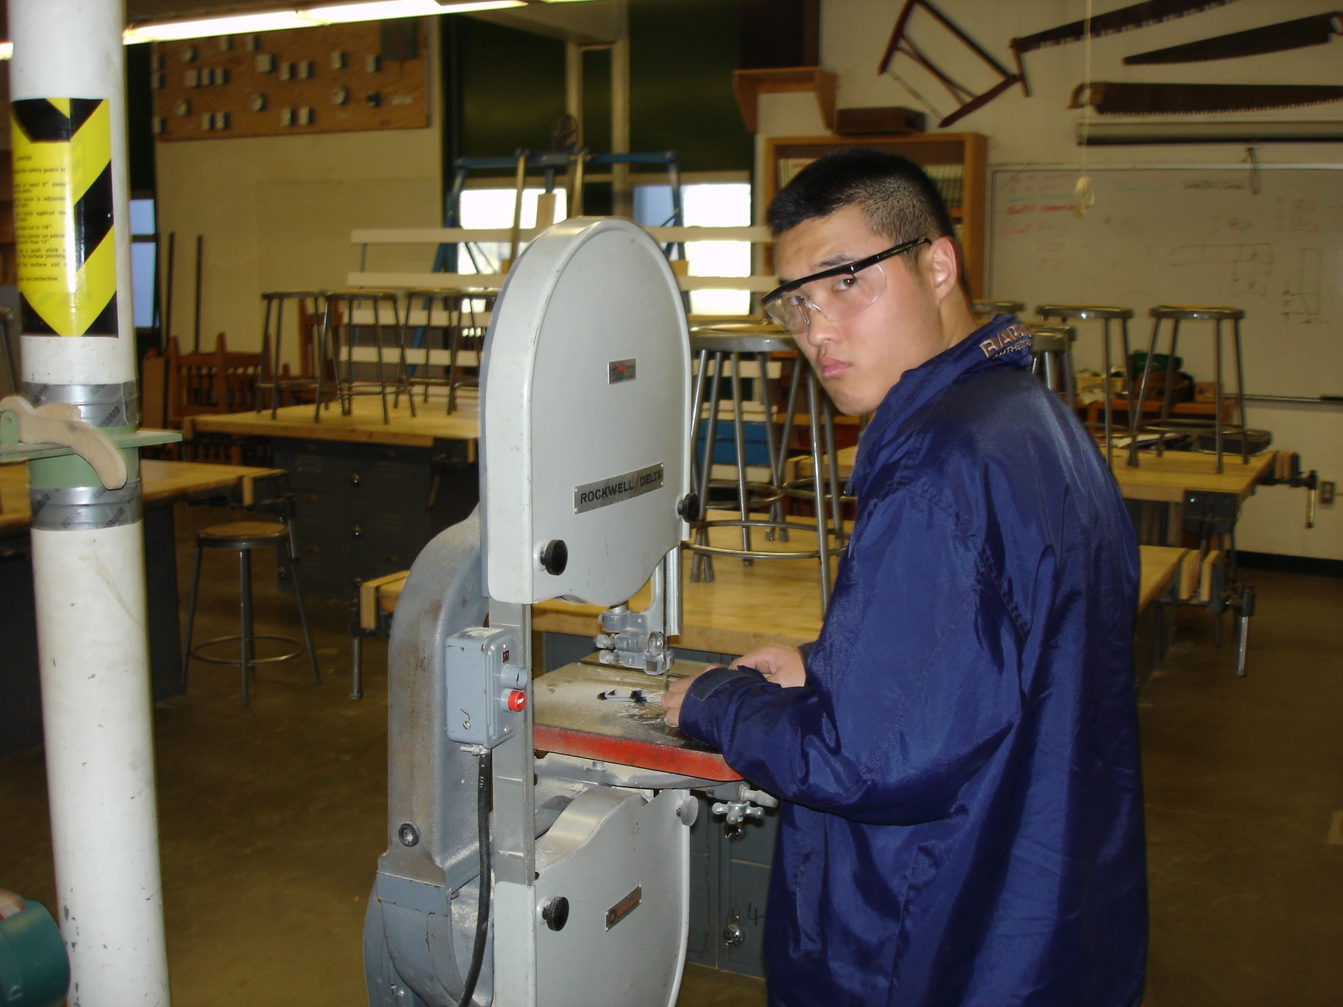
Safety Glasses
Watch what your doing!!
On-Off Switch
Set the guide just high enough to clear the piece, no more than ¼”

Slide 15
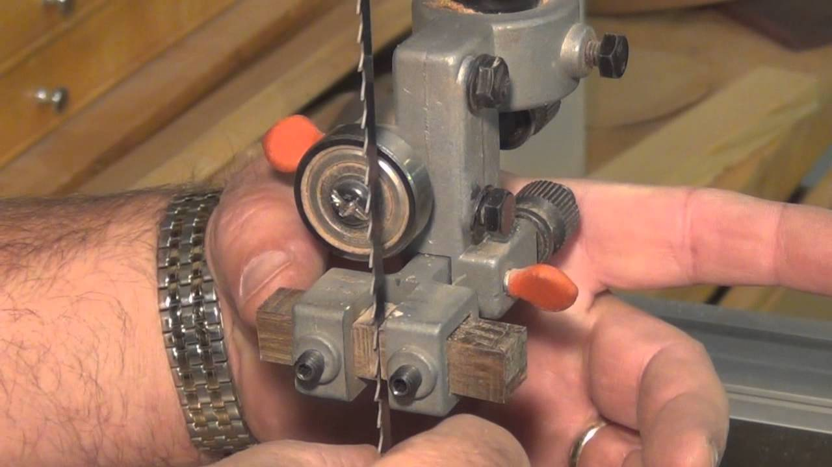
Band Saw
Pay attention to blade tension and alignment!!
Right side of Bearing and back half of blade going through the guides.
Alignment is done above the table AND below!!
<--- Guard

Slide 16
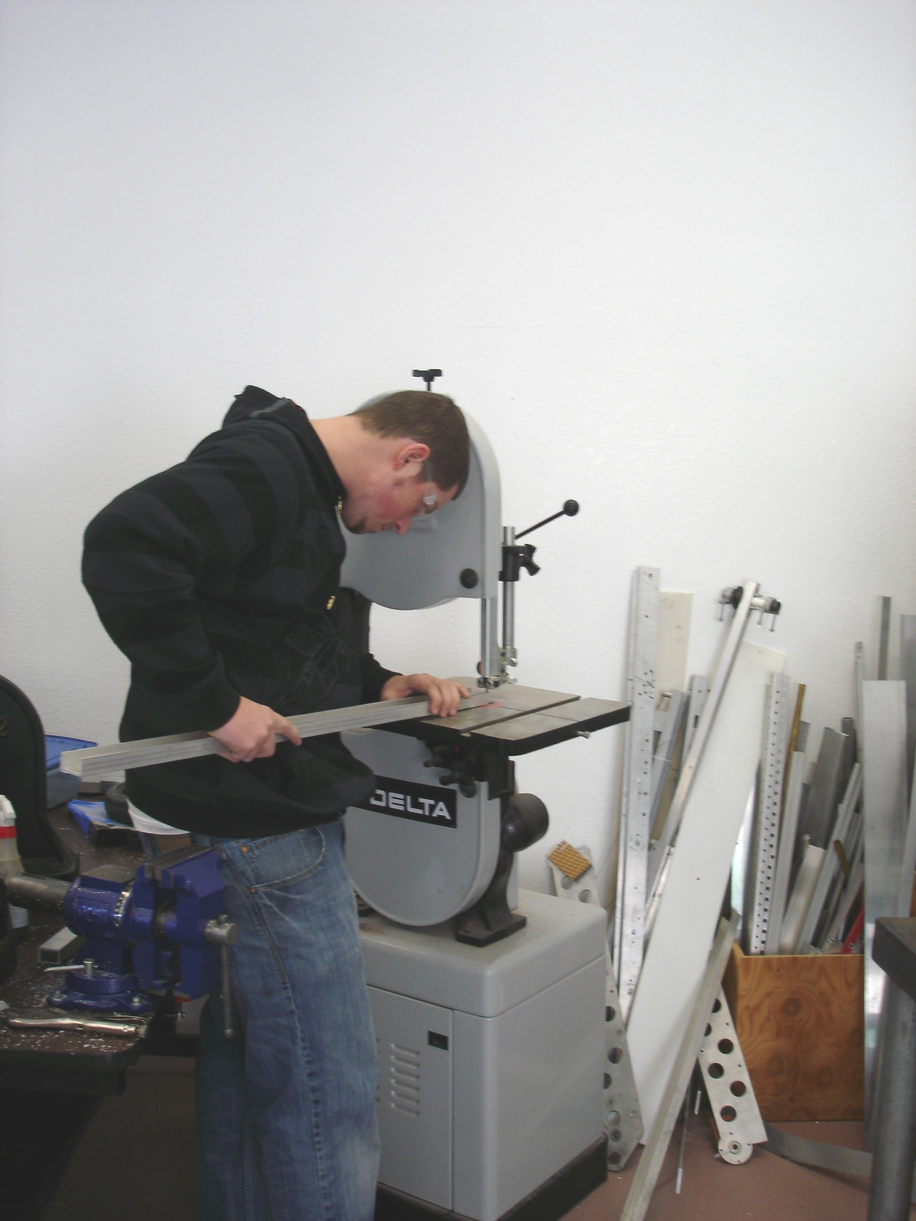
What is he doing safely?
What does he need to do?

Slide 17
Drilling / Milling
Loose clothing out of the way. Hair tied back
Make sure there is clearance under the piece you’re drilling or use a piece of wood under it.
End Mills are sharp, hold them or grab them with a rag.
Make sure the bit is turning the right way.
Bigger the bit, slower the cutting speed!!
Keep the chuck key with the drill!!!!
Steel gets cut at a slower speed than Aluminum.
Use coolant!! Cutting fluid (or hand lotion on aluminum).

Slide 18
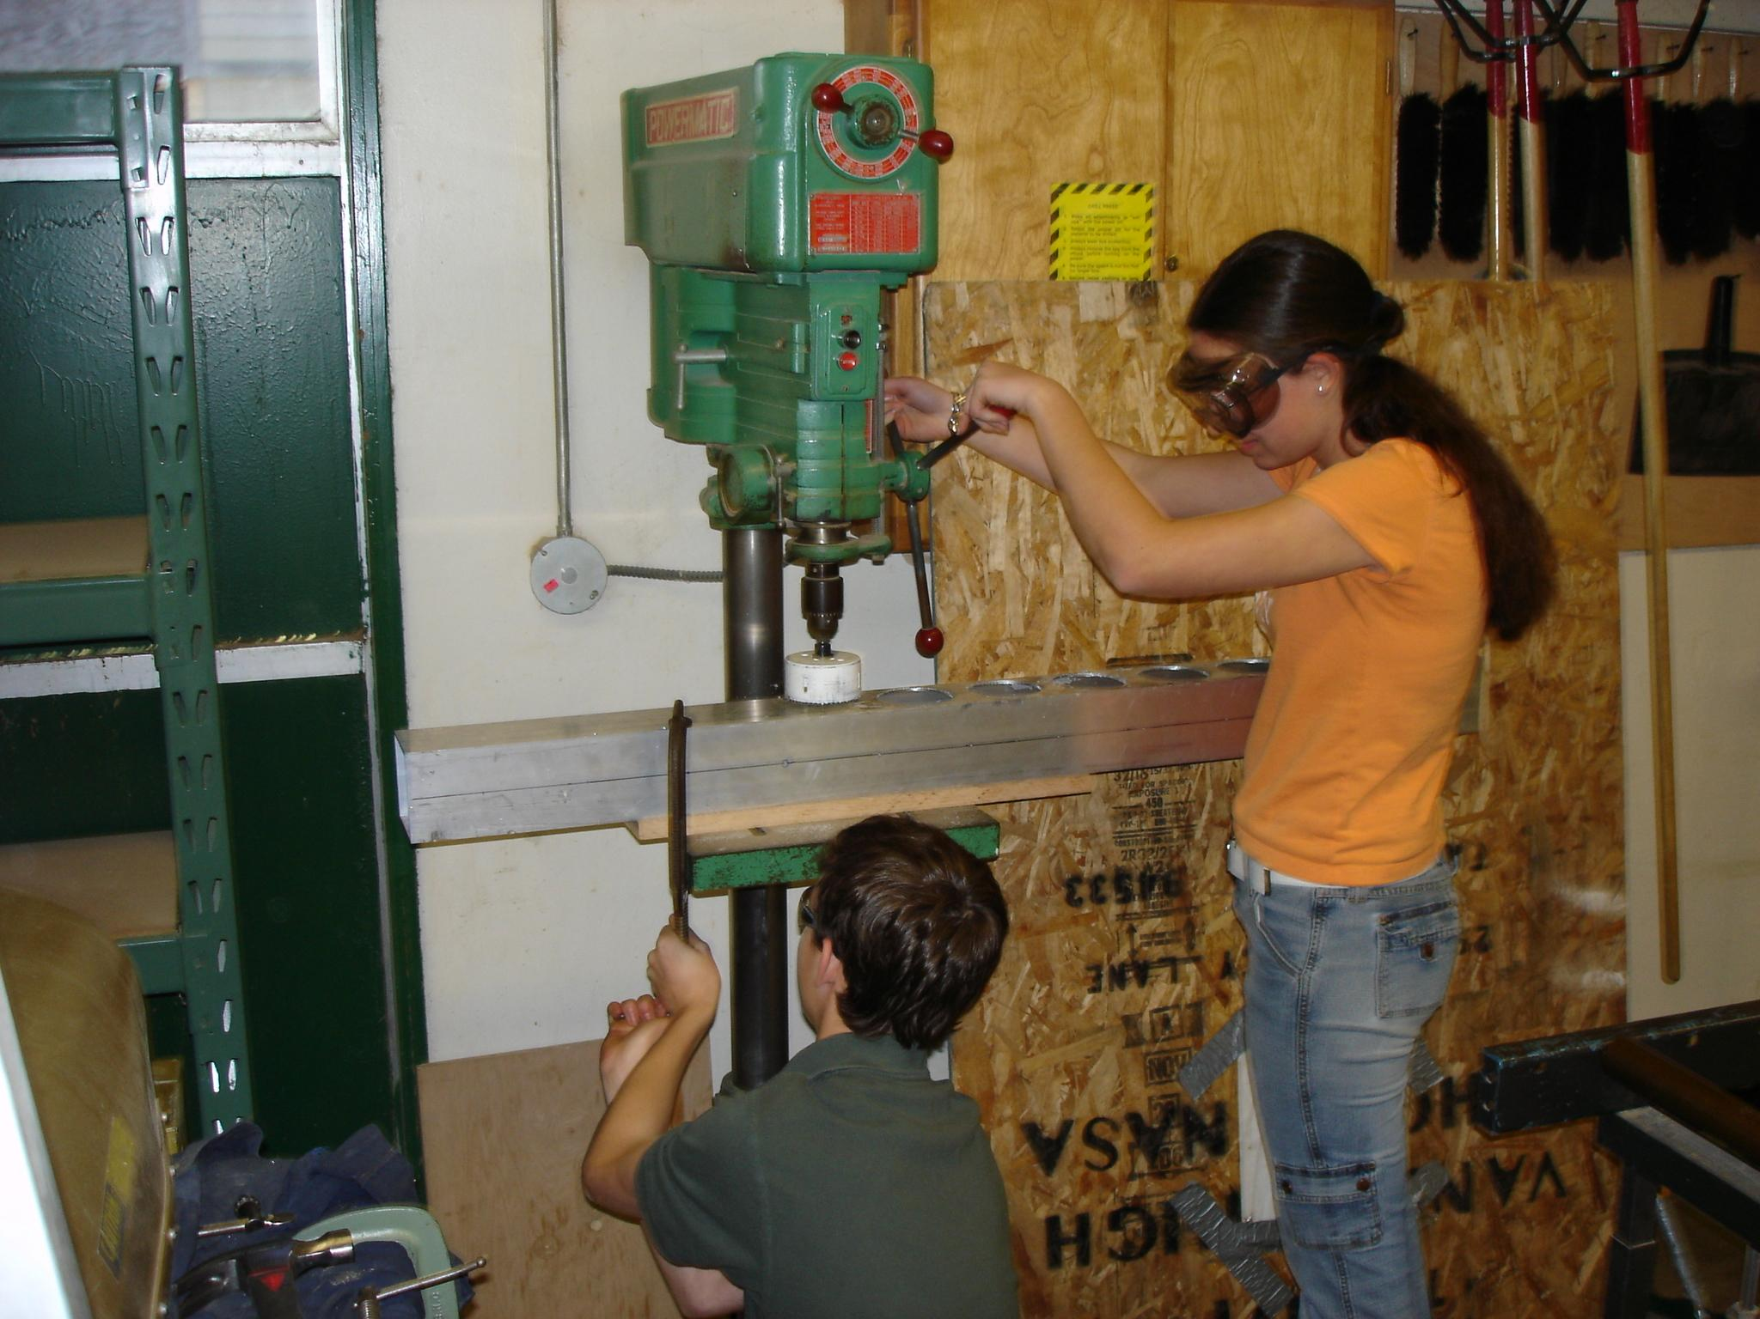

Slide 19
Chop Saw
Loose clothing out of the way and hair tied back
Clamp down the piece your cutting.
Shout “cutting” before turning on
Bring the saw up to speed first, then lower it SLOWLY into the material.
Don’t cut small stuff like vex metal. It will fly off and hurt someone!!
If you will be cutting a lot of material – do it outside since it is so loud.
Wear Ear Protection
SAFETY GLASSES!!!

Slide 20
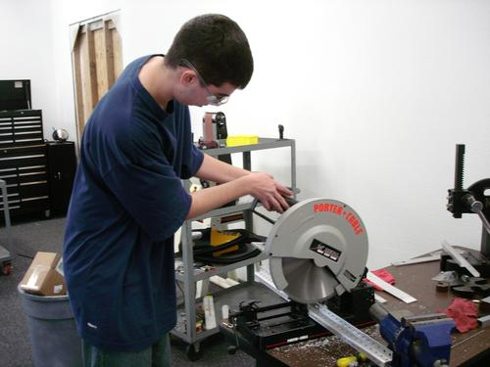

Slide 21
Arbor Press / Broaching
Loose clothing out of the way and hair tied back
If making a keyway, ensure that the broach is lined up with a set screw if one is available.
Some broaches (1/8” and 3/16”) require two passes (the 2nd pass using a shim).
Use coolant or Cutting fluid
The broach should go smoothly – otherwise verify it is not going in crooked – that may cause it to break.
SAFETY GLASSES!!!

Slide 22
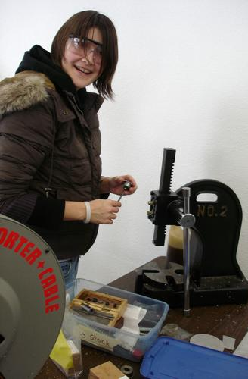
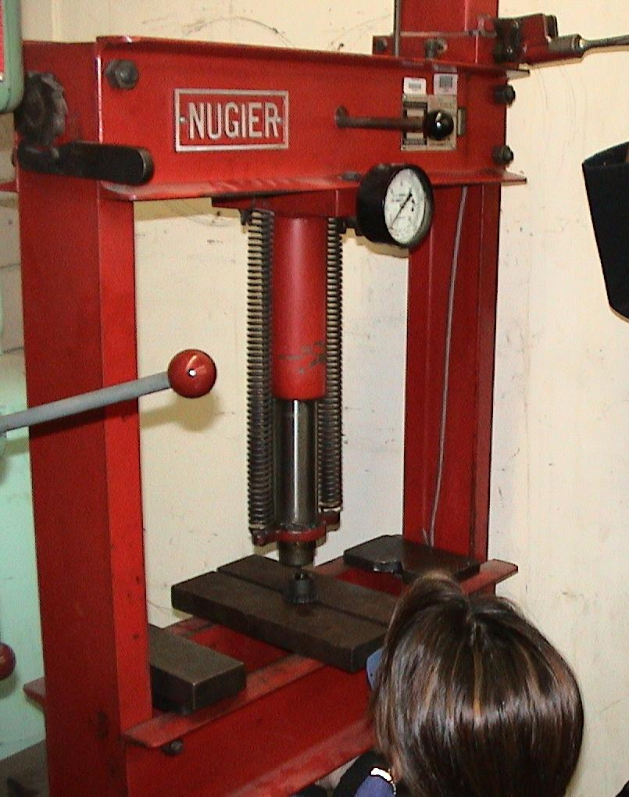
Small Arbor Press
Hydraulic Press in the Auto Shop

Slide 23
Welding
Loose clothing out of the way and hair tied back
Wear EYE PROTECTION, welding lens level 14.
Cover skin, UV from the arc will cause sunburns.
Wear gloves!!
DO NOT TOUCH A WELDED PIECE WITHOUT COOLING IT OFF FIRST!!
Argon bottle should be upright and secured.
The workpiece must be grounded. (So you won’t be electrocuted)

Slide 25
More general stuff…
Understand the safety precautions of the machines your using including the robot itself.
Be proactive with your team – remind them when you see them engage in unsafe practices. If someone reminds you – THANK THEM!!
Rookies, work with a veteran to learn
Notify a mentor or veteran of what you are doing before you do it.
Safety Glasses don’t work if they’re on top of your head!
Get OSHA Certified… See Mr. Green if you’d like.
Get CPR / FIRST AID Certified.

Slide 26
Safety at Competitions
Keep the Pit area clean and clear of clutter.
Pit should always have a Fire Extinguisher, Safety Binder, First Aid Kit, and Baking Soda.
Wear safety glasses while in the pit or on the field.
Wear closed toed shoes in the pit and on the field.
Encourage others to be safe – instead of criticizing them – help them. Hand them a pair of goggles, gloves, C-Clamp, etc…

Slide 27
Safety Violations
If you continually violate safety rules then you can be kicked off the team. BE SAFE!!!
To work in the shop you must pass the safety quiz and/or correct it with a score of 100%.
Our “Safety Binder” is kept in the mechanical room or in the pits. It contains 3 main parts (SDS-Safety Data Sheets, training records (CPR, OSHA Certs, First Aid, etc.., and copies of Student Safety Quizzes)

Slide 28
Our Safety Binder
The safety binder has a name! It is SDS; it stands for:
SAFETY DATA SHEET

